Slide 1
Tiny Machine Learning Ranked Signals

Slide 2
2023-2024

Slide 3
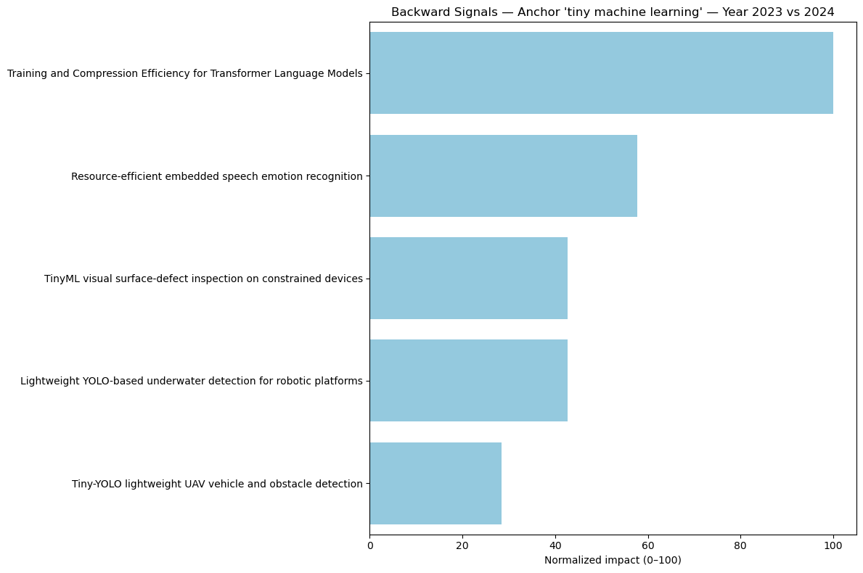

Slide 4
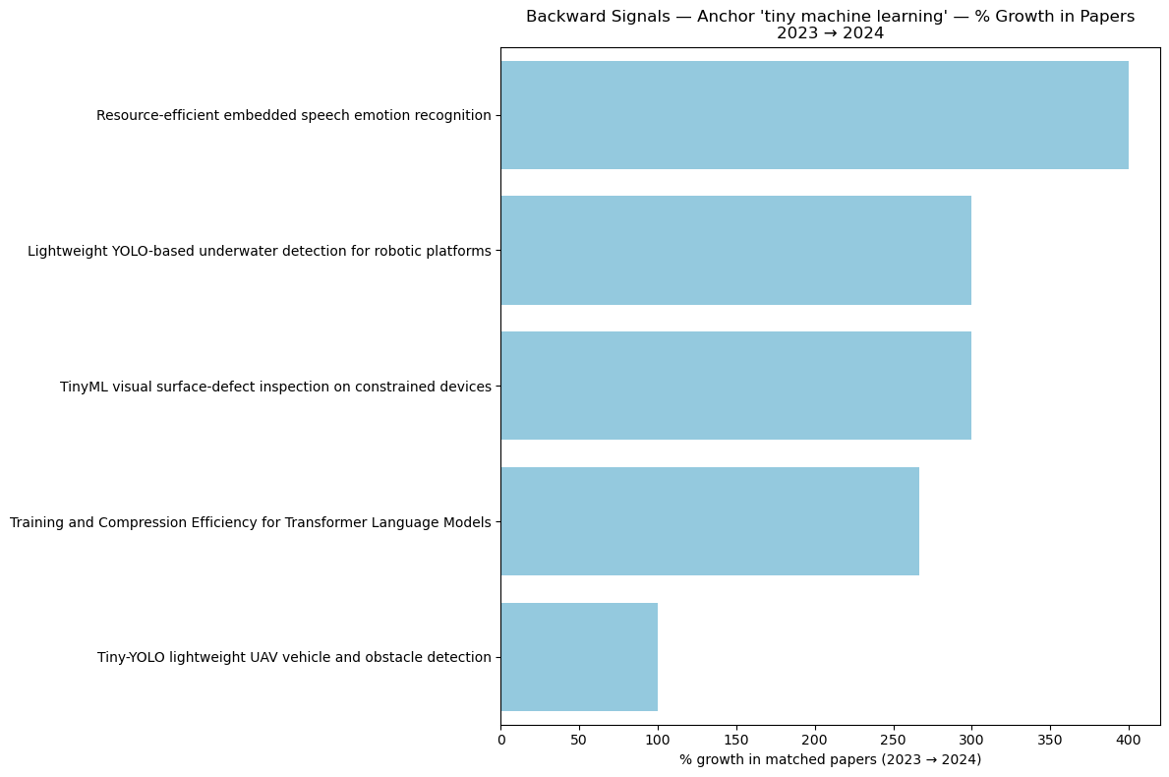

Slide 5
2022-2024

Slide 6
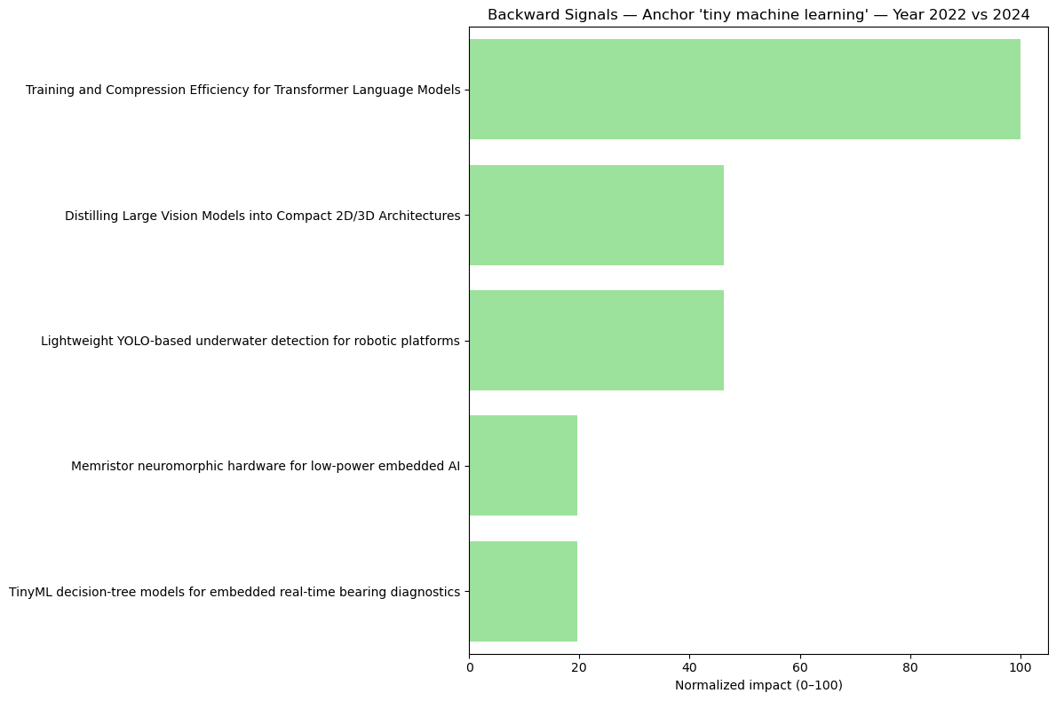

Slide 7
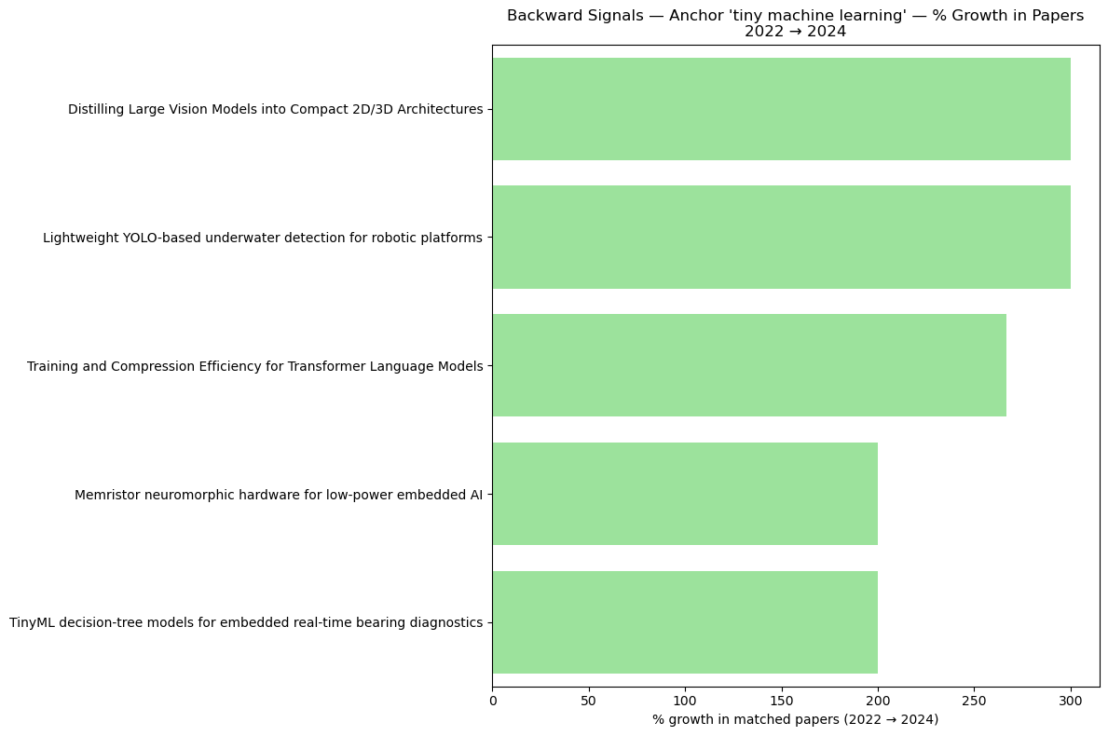

Slide 8
2021-2024

Slide 9
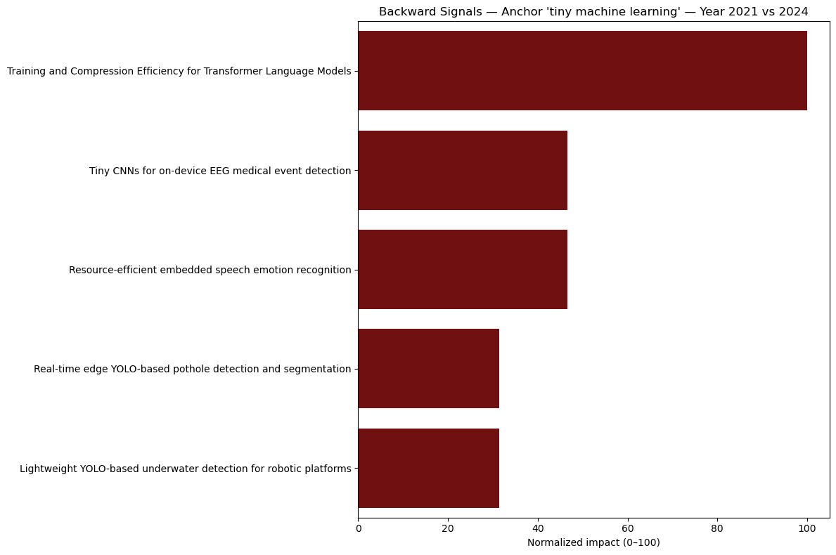

Slide 10
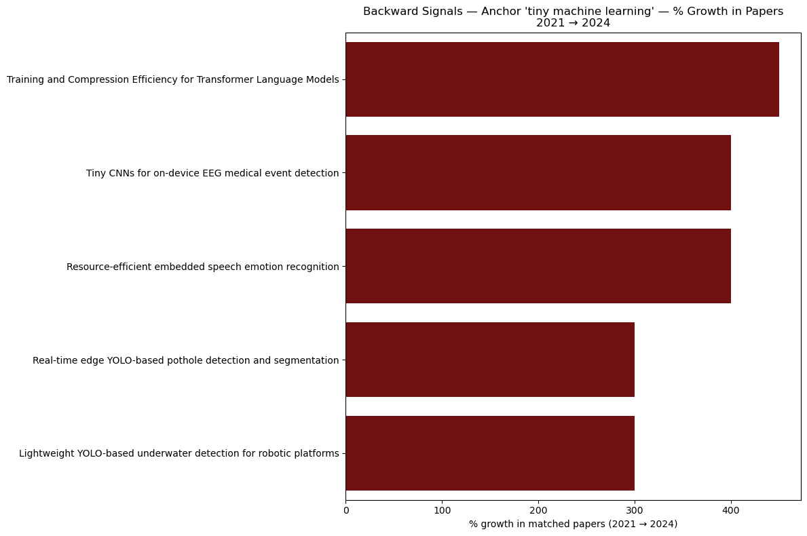

Slide 11
2020-2024

Slide 12
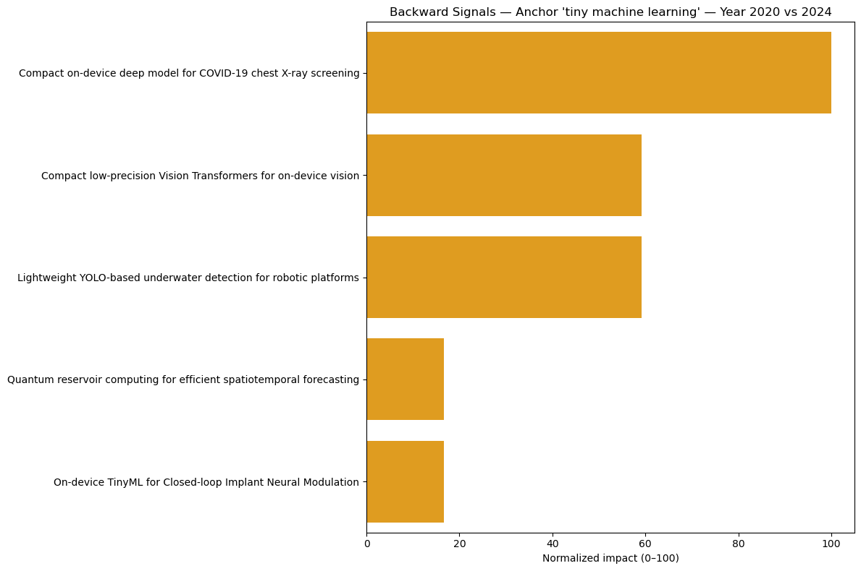

Slide 13
